Slide 1
SPRING VALLEY VILLAGE POLICE DEPARTMENT
MONTHLY NEWSLETTER:
JULY 2025
1025 CAMPBELL ROAD
HOUSTON, TX 77055
PHONE: 713-465-8323
COMMUNITY MATTERS.
WE ARE A TEAM.

Slide 2
INTRODUCTION
Hilshire Village Residents,
Summer is here! Hopefully everyone is being cautious in the summer heat that is upon us.
KEEP IN MIND:
Fireworks are not permitted within the city limits of Hilshire Village.
Lock your vehicle when it is unoccupied.
Be sure to lock all doors and windows in your home, when you are not on the premises.
As always we are here if you need us!
Sincerely,
Chief M. Schulze
1025 CAMPBELL ROAD, HOUSTON, TX 77055
PHONE: 713-465-8323 / EMAIL: DISPATCH@SPRINGVALLEYTX.COM

Slide 3
JULY 2025
DATE | DAY | SPECIAL DAYS FOR THIS MONTH
07-04-2025 | FRIDAY | FOURTH OF JULY
07-04-2025 | FRIDAY | CITY HALL CLOSED
COMMUNITY MATTERS.
WE ARE A TEAM.
1025 CAMPBELL ROAD, HOUSTON, TX 77055 / PHONE: 713-465-8323 / EMAIL: DISPATCH@SPRINGVALLEYTX.COM

Slide 4
COMMUNITY MATTERS.
WE ARE A TEAM.
1025 CAMPBELL ROAD, HOUSTON, TX 77055 / PHONE: 713-465-8323 / EMAIL: DISPATCH@SPRINGVALLEYTX.COM

Slide 5
COMMUNITY MATTERS.
WE ARE A TEAM.
1025 CAMPBELL ROAD, HOUSTON, TX 77055 / PHONE: 713-465-8323 / EMAIL: DISPATCH@SPRINGVALLEYTX.COM

Slide 6
COMMUNITY MATTERS.
WE ARE A TEAM.
1025 CAMPBELL ROAD, HOUSTON, TX 77055
PHONE: 713-465-8323 / EMAIL: DISPATCH@SPRINGVALLEYTX.COM

Slide 7
Suspicious Activity
Suspicious activity is any observed behavior that could indicate a person may be involved in a crime or about to commit a crime. Leaving packages, bags or other items behind. Exhibiting unusual mental or physical symptoms. Unusual noises like screaming, yelling, gunshots or glass breaking. Individuals in a heated argument, yelling or cursing at each other. Unusual items or situations: A vehicle is parked in an odd location, a package is left unattended, a window or door is open that is usually closed, or other out-of-the-ordinary situations occur.
Sgt. T. Wood
If you observe anything that you may feel is suspicious, you can call our non-emergency line 713-465-8323.
Example of Suspicious Activity:
An individual peering into vehicle, to try and locate any valuables left unattended
An individual trying door handles to vehicles, and/or residences to gain access to the vehicle and/or residence
An individual checking front doors of residences to locate any unattended packages, or individuals following delivery trucks to see where the truck is dropping off packages.
COMMUNITY MATTERS.
WE ARE A TEAM.
1025 CAMPBELL ROAD, HOUSTON, TX 77055 / PHONE: 713-465-8323 / EMAIL: DISPATCH@SPRINGVALLEYTX.COM

Slide 8
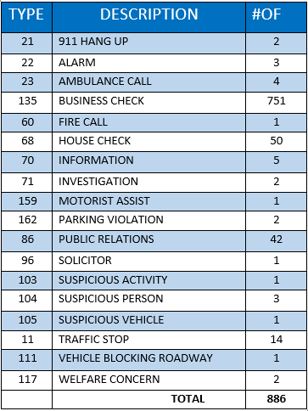
SPRING VALLEY POLICE DEPARTMENT
HILSHIRE VILLAGE
CALLS BY TYPE: 06-01-2025 THRU 06-30-2025
COMMUNITY MATTERS.
WE ARE A TEAM.
1025 CAMPBELL ROAD, HOUSTON, TX 77055
PHONE: 713-465-8323 / EMAIL: DISPATCH@SPRINGVALLEYTX.COM

Slide 9
IMPORTANT NUMBERS AT A GLANCE
EMERGENCY |  | NON - EMERGENCY
911 - FOR ALL EMERGENCY |  | 713-465-8323
988 – NATIONAL SUICIDE & MENTAL HEALTH
SPRING VALLEY VILLAGE |  | VILLAGE FIRE DEPARTMENT
SPRING VALLEY - CITY HALL | 713-465-8308 | VILLAGE FIRE DEPARTMENT |  | 713-465-2323
SPRING VALLEY - PD | 713-465-8323 | VFD - NON-EMERGENCY |  | 713-468-7941
SPRING VALLEY - PD FAX | 713-465-3135
SPRING VALLEY - COURT | 713-465-0333
HILSHIRE VILLAGE
HILSHIRE VILLAGE – CITY HALL | 713-973-1779
COMMUNITY MATTERS.
WE ARE A TEAM.
1025 CAMPBELL ROAD, HOUSTON, TX 77055 / PHONE: 713-465-8323 / EMAIL: DISPATCH@SPRINGVALLEYTX.COM

